Slide 1
Unit 1 Food matters
Project
舒秀花 湖南省株洲市第四中学

Slide 2
舒秀花
株洲市“教学能手”
株洲市第八届“教坛新秀”
株洲市四中“青年教师素养”大赛特等奖
两次参与株洲市一模命题审题工作
参与编著湖南省教育科学“十三五”规划2017年度立项重点课题成果《中学英语“核”动力特色教学》

Slide 3
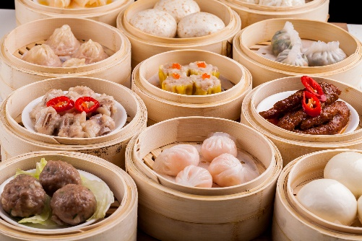
Step
1
Lead-in
Free talk
· What do you have for breakfast/lunch/dinner?
· What is your favourite dish?
· Do you know how to make it?
· Do you want create some new dishes?

Slide 4
Step
1
Lead-in
Task assignment
The school English club will hold a Food Festival, and we are invited to make a dish. So, in this class we’ll learn how to write a recipe and make a dish.

Slide 5
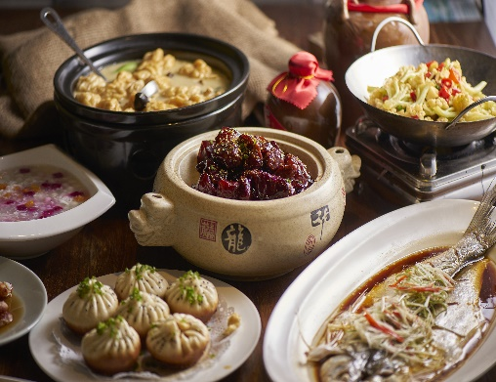
Step
2
Deciding on the dish to research
1. Have a discussion and choose a dish to research or create a new dish.
2. Have a discussion and decide what kinds of information are needed.
• Ingredients
• Instructions
• Tips
...

Slide 6
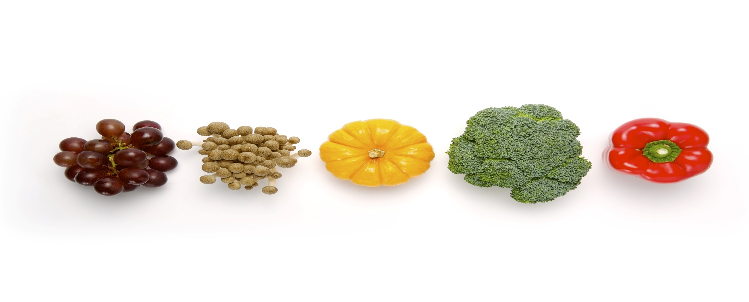
Step
3
Learning to write a recipe
What is a recipe?
A recipe is a set of instructions that tells you how to cook something and the ingredients you need for it.

Slide 7
Step
3
Learning to write a recipe
Read the example in part B of the textbook and find out the basic elements of a recipe.
Name of the dish
Main ingredients
A recipe
Instructions
Dos
Tips
Don’ts

Slide 8
Step
3
Learning to write a recipe
Tips for writing a recipe:
· Provide exact figures about the amount of ingredients and time need when possible.
· Employ specific and accurate verbs to give instructions.
· List the instructions in order.
· Add some tips if necessary.

Slide 9
Step
4
Task division
Discuss in groups to think about all the work that needs to be done and how to divide the work properly among the group members.
• Search for information.
• Organize the information to write a recipe.
• Prepare ingredients and make a dish.
• Record the process of making the dish.
• Make a presentation.

Slide 10
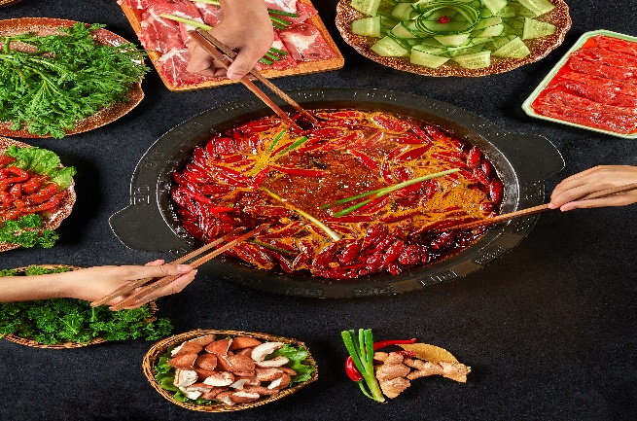
4
Task division
Step
Tips for recording the process of making a dish.
· Use devices with high-resolution.
· Record important steps.
· Polish your material after recording.

Slide 11
5
Presentation and assessment
Step
Tips for making a presentation.
· Speak clearly and confidently.
· Make eye contact with the audience.
· Keep your facial expressions relaxed and friendly.
· Talk at a proper speed and pause when it is necessary to give your audience time to think about what you have said.

Slide 12
Give points according to every team’s performance (10 points in total) and give some suggestions.
Oral presentation | 4 | Total
Photos/video | 4
Teamwork | 2

Slide 13
________________________________________________________________________________________________________________________________________________________________________________________________________________________________________________________________________________________________________________________________________________________________________
Homework
Make improvements to the works of your group according to your classmates’ comments and suggestions.
Share each group’s work and appreciate other’s works.

